Slide 1

BASIC ELECTRICAL AND ELECTRONICS ENGINEERING
Course Code: CSE1002
SCHOOL OF COMPUTER SCIENCE ENGINEERING AND APPLICATIONS
Mrunmayee Rahate
Assistant Professor, DYPIU

Slide 2
Module 3: Bipolar Junction Transistors and MOSFET
Lecture 2: BJT Configurations: Common Base, Common Emitter, Common Collector and Characteristics

Slide 3
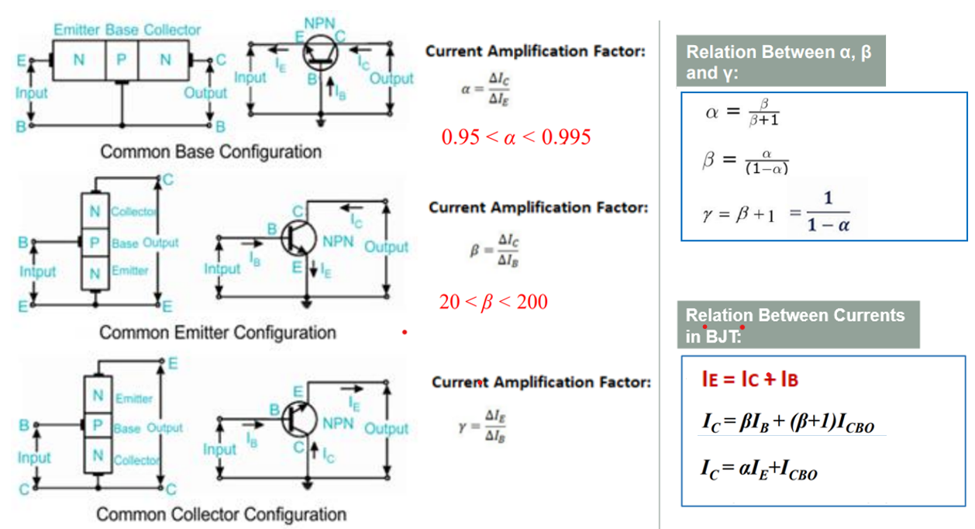
Bipolar Junction Transistor: configurations

Slide 4
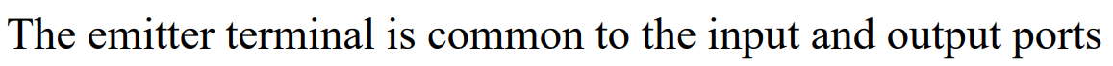
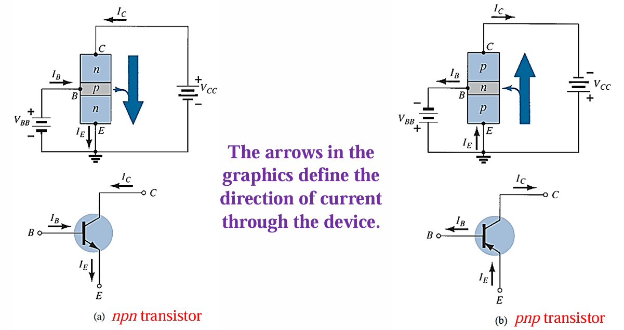
Bipolar Junction Transistor: Common Emitter (cE) configuration

Slide 5
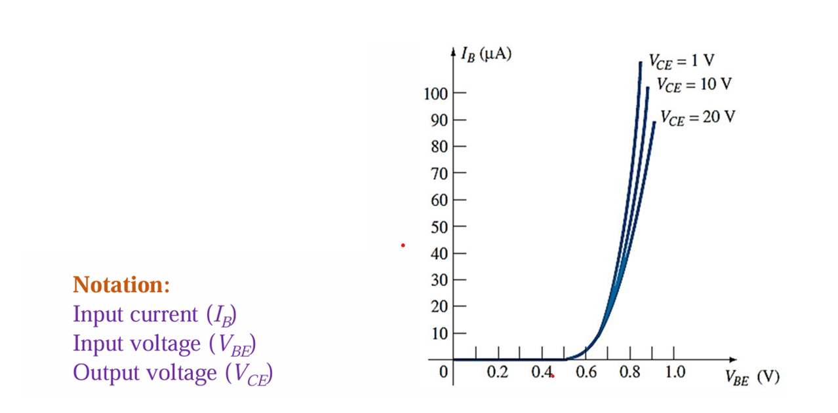
Bipolar Junction Transistor: Common Emitter (cE) configuration – Input dc characteristics

Slide 6
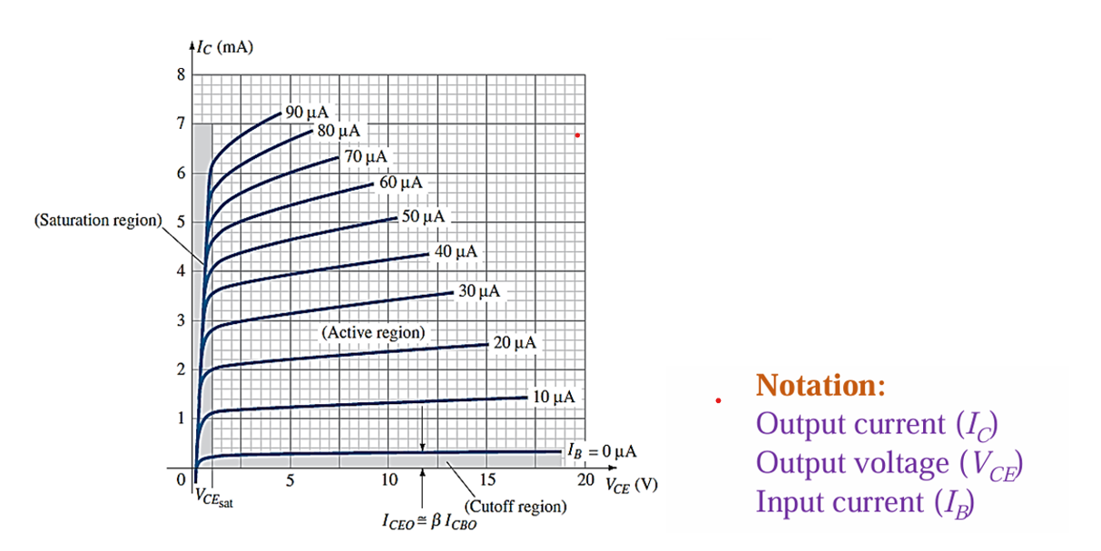
Bipolar Junction Transistor: Common Emitter (cE) configuration – output dc characteristics

Slide 7
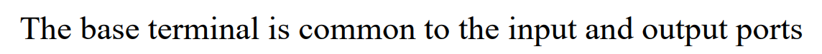
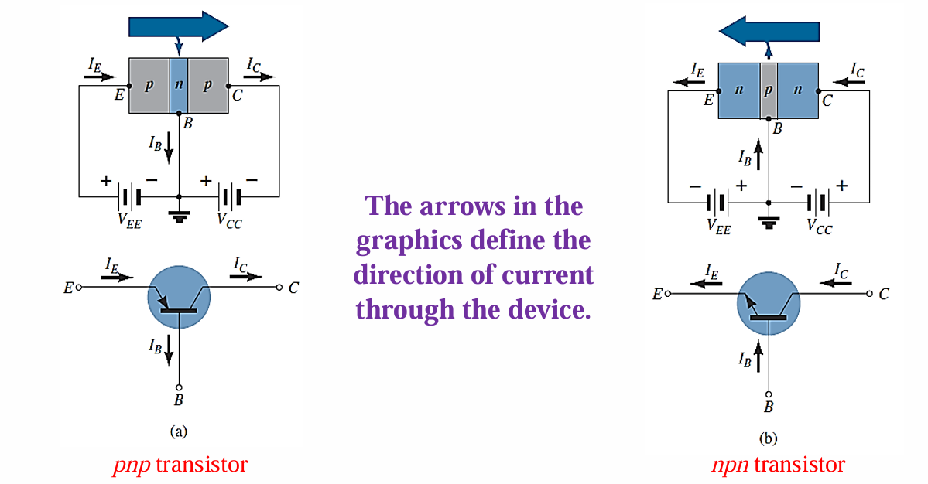
Bipolar Junction Transistor: Common base (cb) configuration

Slide 8
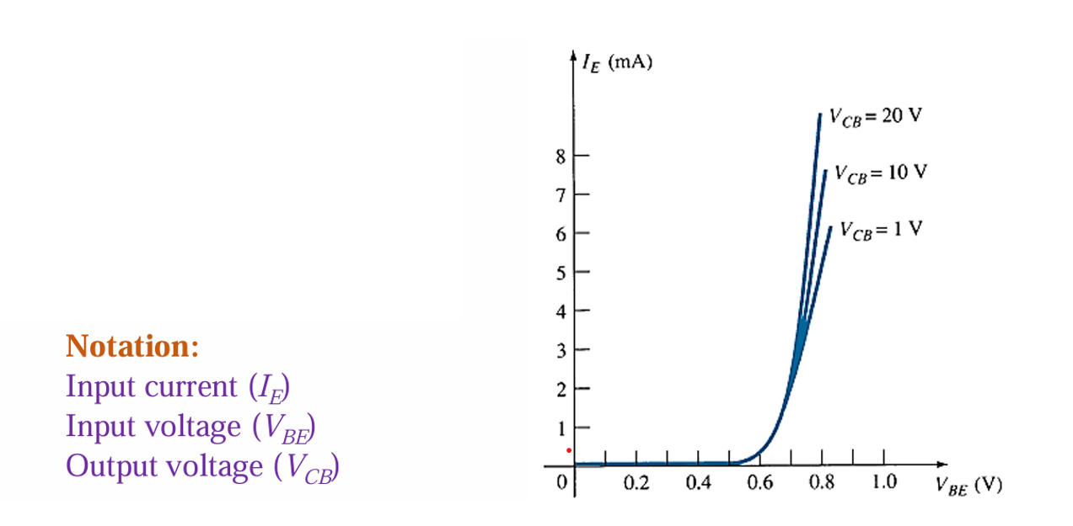
Bipolar Junction Transistor: Common base (cb) configuration – Input dc characteristics

Slide 9
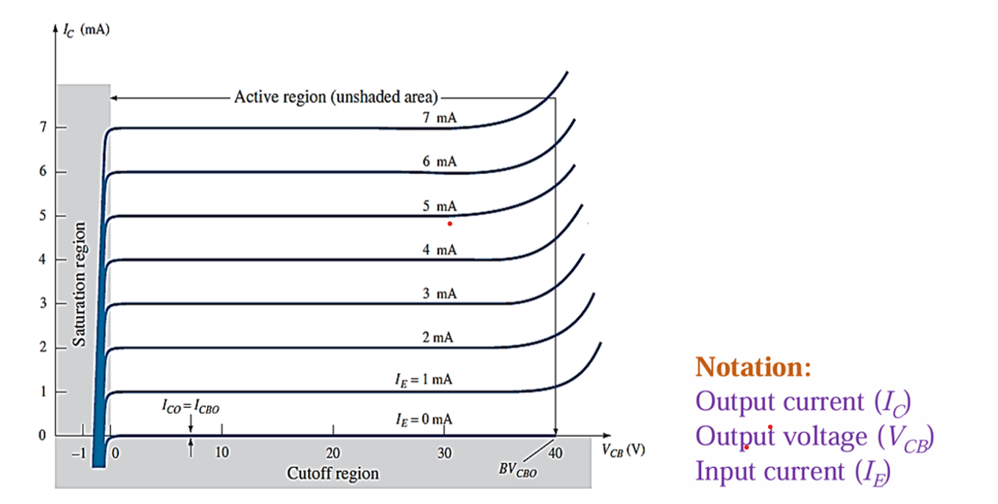
Bipolar Junction Transistor: Common base (cb) configuration – output dc characteristics

Slide 10
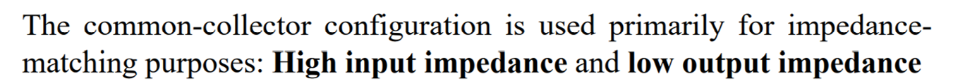
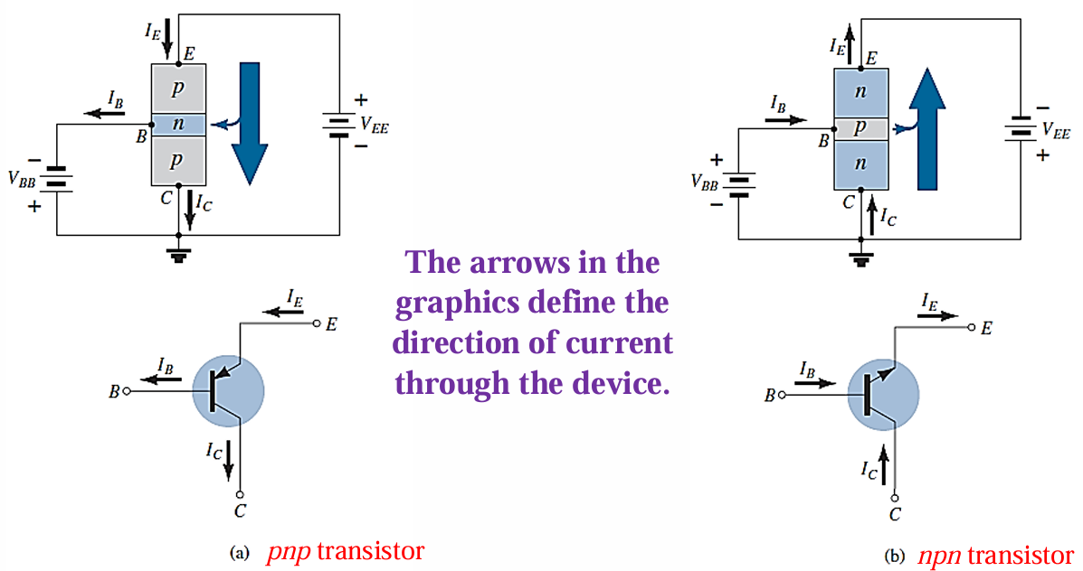
Bipolar Junction Transistor: Common Collect0r (cc) configuration

Slide 11
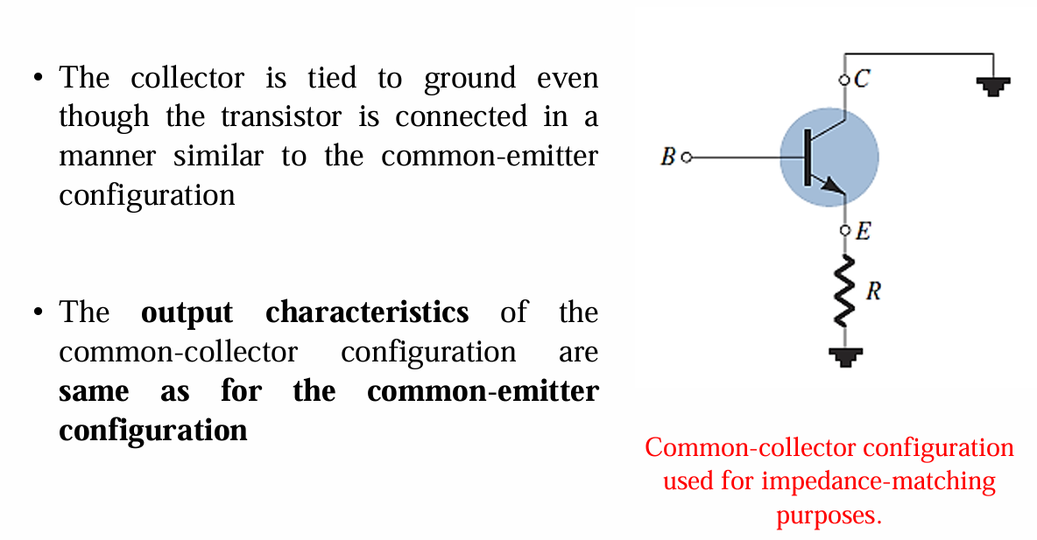
Bipolar Junction Transistor: Common Collect0r (cc) configuration

Slide 12
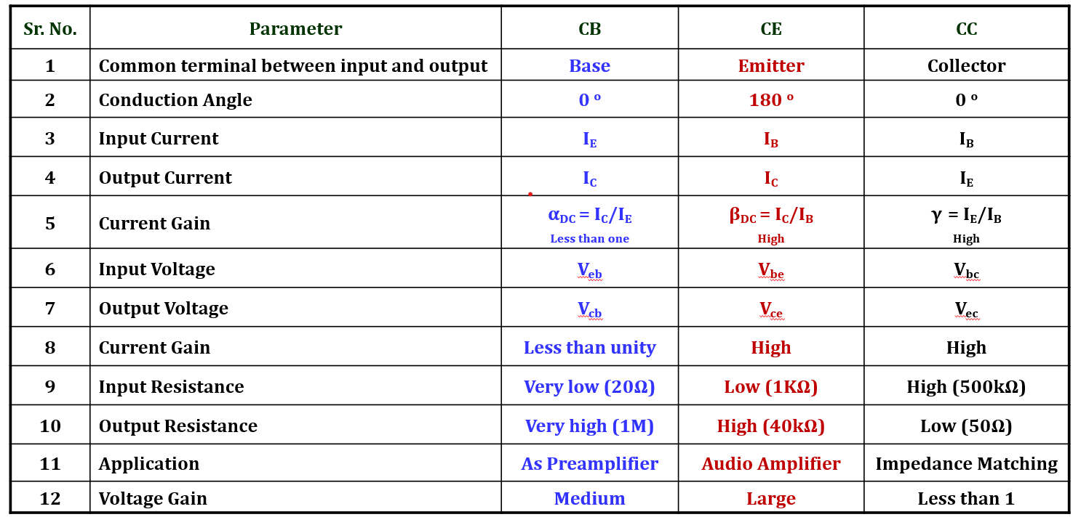
Bipolar Junction Transistor: configuration summery

Slide 13
Thank You !!!

